Slide 1


PASSENGER POSITIONING SYSTEM

Slide 2
Table Of Contents
01
02
03
INTRODUCTION
OBJECTIVES
METHODOLOGY
Background
Problem Statement.
General Objectives
Specific Objectives
Materials
Methods.
03
04
05
ANALYSIS AND DESIGN
IMPLEMENTATION AND RESULTS
CONCLUSION
Requirements gathering.
DESIGN

Slide 3
1/1
Background
Mobile app development is rapidly growing, from retail, telecommunications and e-commerce to insurance, healthcare and government.
To stay relevant, responsive and successful, organizations need to develop the mobile applications that their customers, partners and employees demand.

Slide 4
1/1
Problem statement
The passenger-driver system is experiencing issues accurately tracking the location of passengers within a vehicle. This is causing delays in pick-up times and over consumption of fuel.
The goal is to identify and resolve the underlying issues to improve the overall efficiency and reliability of the system

Slide 5
2/1
General Objectives
Provide a hassle-free, user-friendly and efficient taxi service experience to passengers.
Increase the efficiency of the taxi industry by reducing empty trips and analyzing passenger and driver data to optimize routes

Slide 6
2/2
Specific Objectives
Reduce the pickup time for drivers, making the ride-sharing process more efficient and convenient.
Improve the communication between passengers and drivers
Reduce the pickup time for drivers in finding the passengers location and make the passengers journey more comfortable by elimination the need for search for the car.

Slide 7
Materials and methods
3/1
Study design : Analytical study
Study setting : Buea city
Study population : target users
Inclusion Criteria: Survey feedback from a good number of people in Buea city.

Slide 8
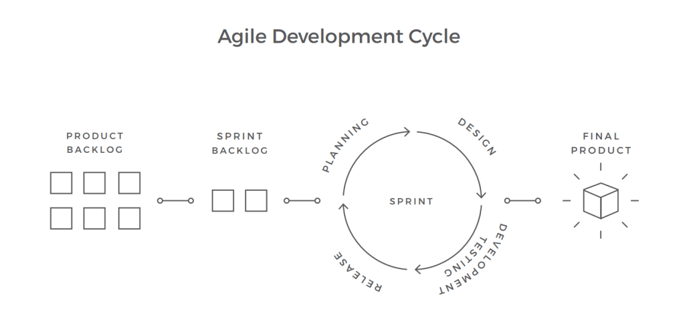
Material and methods
3/2

Slide 9

ANALYSIS AND DESIGN
4
Requirements gathering
UML Design
UI/UX Design
Database Design

Slide 10
Thank You!

